Slide 1
TSMC
Financial Model & Revenue Analysis
FY2024A - FY2028E Projections | Base Case Scenario
March 2026
Taiwan Semiconductor Manufacturing TWSE: 2330 | NYSE: TSM
FY2025A Revenue
YoY Growth
Gross Margin
HPC Share
NT$3,809B
+31.6%
59.9%
57.6%

Slide 2
This presentation contains forward-looking statements based on current expectations and assumptions subject to risks and uncertainties. Actual results could materially differ. Model assumptions represent illustrative scenarios based on TSMC FY2025 Consolidated Financial Statements. This analysis is for informational purposes only and should not be construed as investment advice.
TSMC 2

Slide 3
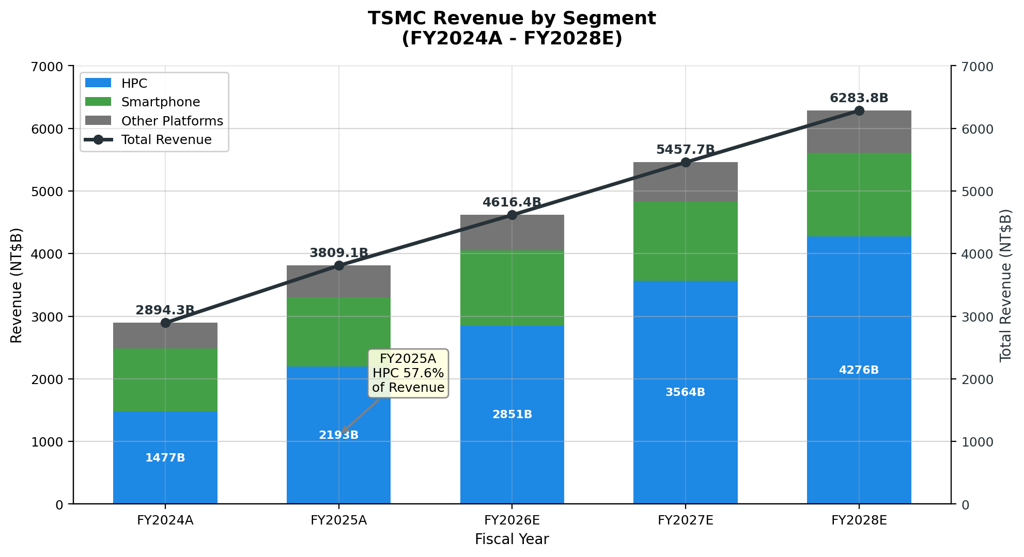
Executive Summary
Key Highlights
Revenue FY2025A
NT$3,809B
+31.6% YoY
HPC Segment
57.6%
+48.5% YoY
Gross Margin
59.9%
Industry Leading
FY28E CAGR
18.2%
Base Case
Metric | FY2025A | FY2028E | CAGR
Total Revenue | NT$3,809B | NT$6,284B | 18.2%
Net Income | NT$1,715B | NT$2,503B | 13.4%
EPS | NT$66.26 | NT$96.54 | 13.4%
TSMC 3

Slide 4
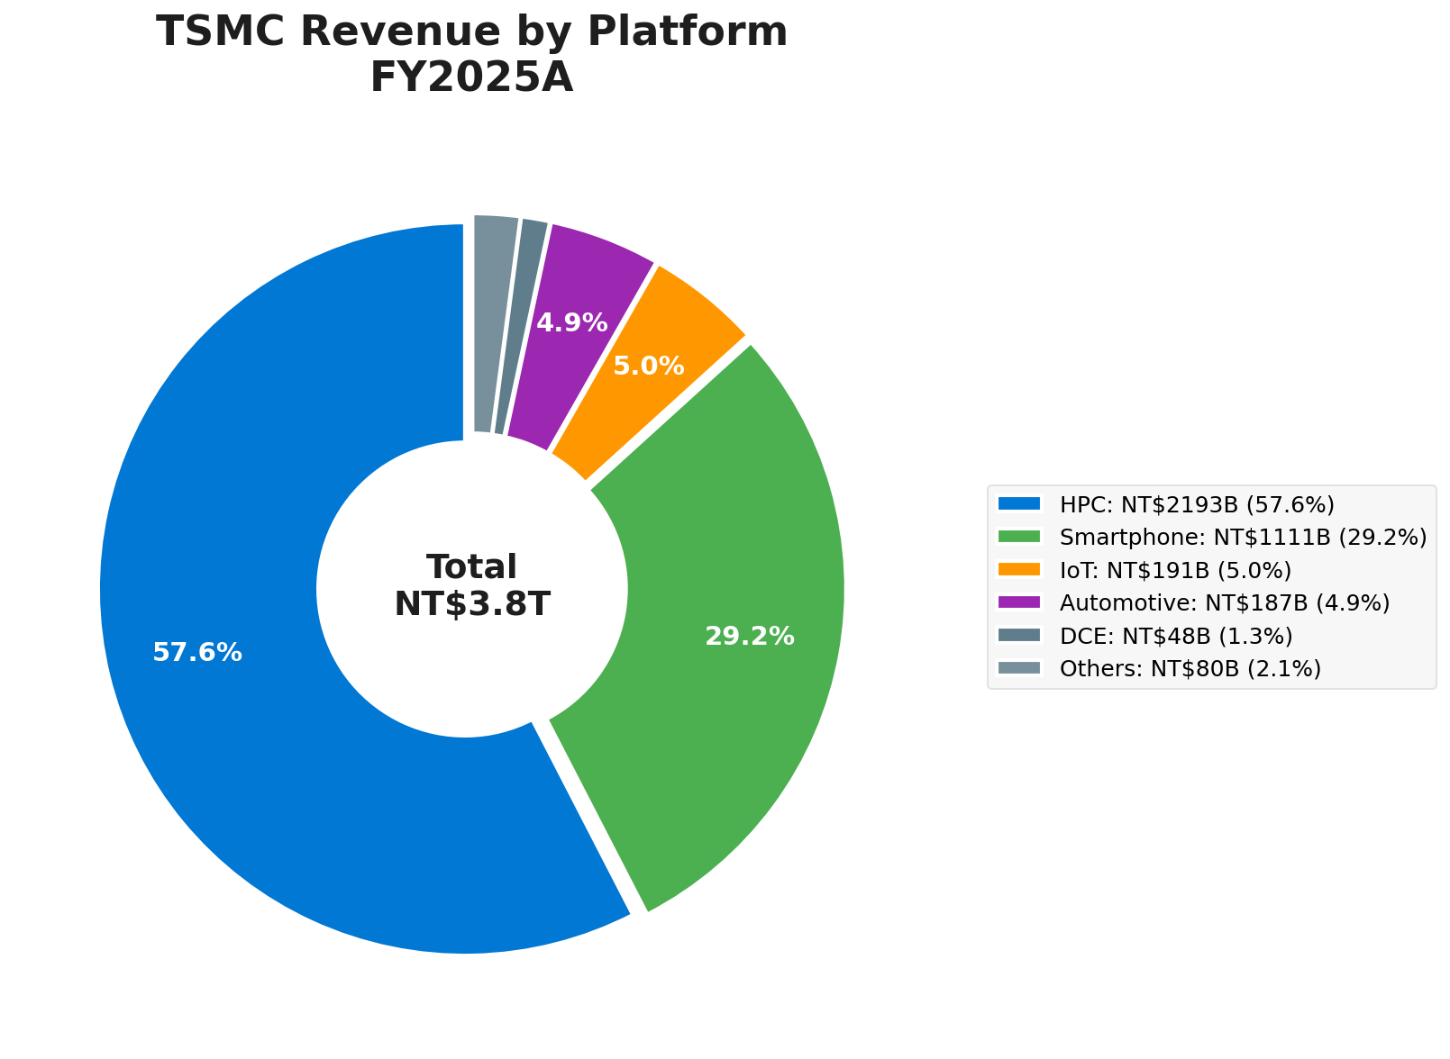
Revenue by Platform Segment
FY2025A Platform Revenue
High Performance Computing
NT$2,193B
57.6%
Smartphone
NT$1,111B
29.2%
IoT
NT$191B
5.0%
Automotive
NT$187B
4.9%
DCE & Others
NT$128B
3.4%
AI-Driven HPC Dominance
HPC grew 48.5% YoY, now representing nearly 60% of total revenue driven by AI accelerator demand
TSMC 4

Slide 5
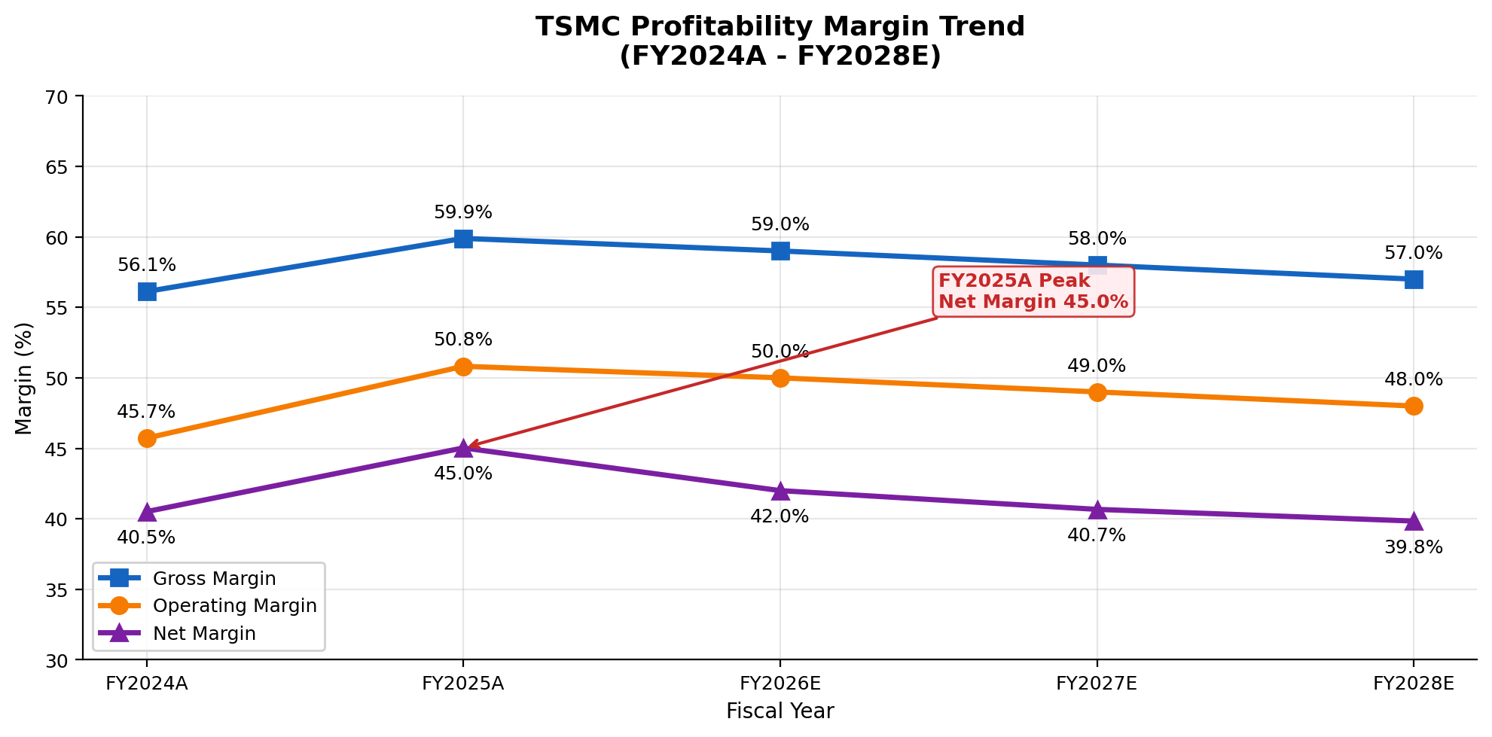
Profitability & Margin Analysis
FY2025A Performance
Gross Margin
59.9%
Peak Level
Operating Margin
50.8%
+3.1pp YoY
Net Margin
45.0%
+4.5pp YoY
EPS
NT$66.26
+46.4% YoY
Outlook: Gradual margin compression expected through FY2028E due to capacity expansion investments
TSMC 6

Slide 6
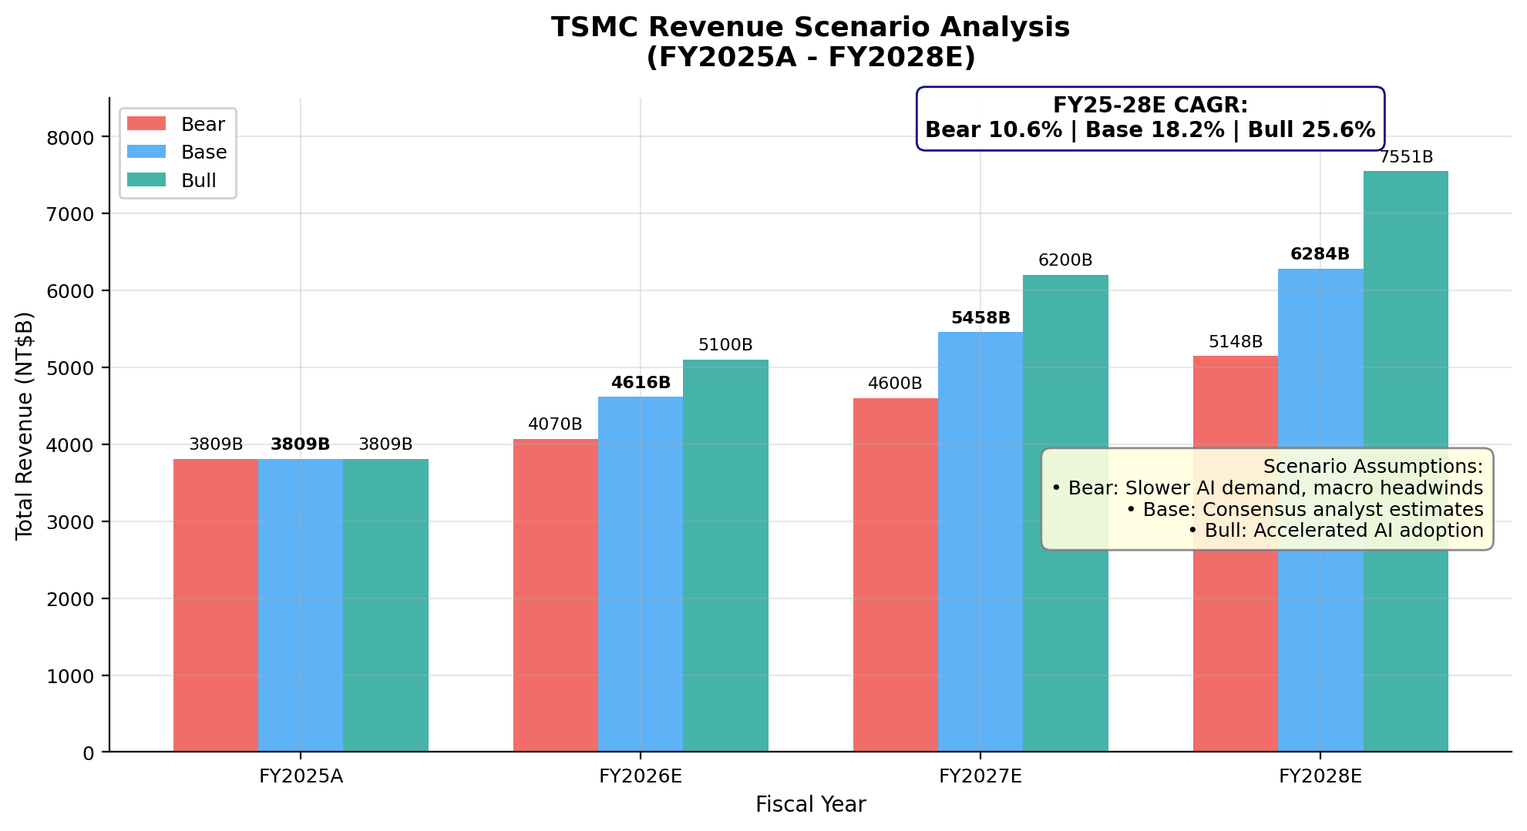
Revenue Scenario Analysis
FY2028E Scenarios
Bear Case
NT$5,148B
Slower AI demand
10.6% CAGR
Base Case
NT$6,284B
Consensus estimates
18.2% CAGR
Bull Case
NT$7,551B
AI acceleration
25.6% CAGR
TSMC 7

Slide 7
Financial Projections (Base Case)
NT$ Millions | FY2025A | FY2026E | FY2027E | FY2028E | CAGR
HPC Revenue | 2,192,931 | 2,850,810 | 3,563,513 | 4,276,215 | 24.9%
Smartphone | 1,110,816 | 1,199,681 | 1,271,662 | 1,335,245 | 6.3%
Other Platforms | 505,307 | 565,944 | 622,538 | 672,341 | 10.0%
Total Revenue | 3,809,054 | 4,616,435 | 5,457,713 | 6,283,802 | 18.2%
Gross Profit | 2,281,294 | 2,723,697 | 3,165,474 | 3,581,767 | -
Gross Margin % | 59.9% | 59.0% | 58.0% | 57.0% | -
Operating Income | 1,936,092 | 2,308,218 | 2,674,279 | 3,016,225 | 15.9%
Net Income | 1,715,397 | 1,938,903 | 2,219,652 | 2,503,467 | 13.4%
EPS (NT$) | 66.26 | 74.77 | 85.59 | 96.54 | 13.4%
TSMC 8

Slide 8
TSMC
Investment Thesis
• Dominant position in advanced semiconductor manufacturing
• Primary beneficiary of AI chip demand surge
• Industry-leading margins with strong cash flow generation
• 18.2% revenue CAGR projected through FY2028E
FY2025A Revenue
Gross Margin
EPS FY28E
Revenue CAGR
NT$3,809B
59.9%
NT$96.54
18.2%
TSMC 9

